Slide 1





⥫
Transforming Challenges into Solutions:
Weather-app
By Vedant Deshpande
Unified Mentor Internship Project

Slide 2






Introduction to the Project
Search Weather by City – Enter a city name to get real-time weather updates.
The Weather App is a simple yet powerful web application that provides real-time weather updates for any city using the OpenWeatherMap API. Built with HTML, CSS (Tailwind CSS), and JavaScript, the app dynamically displays temperature, weather conditions, and location details with intuitive Font Awesome icons.
This web app allows users to:
Search Weather by City – Enter a city name to get real-time weather updates.
Display Weather Details – Shows temperature, weather conditions, and location.
Use Dynamic Icons – Weather conditions are visually represented with Font Awesome icons.

Slide 3






Identifying Challenges
During the development of the Weather-App, I encountered several challenges that needed to be addressed to ensure a smooth user experience:
🔹 API Limitations– Free-tier API has rate limits, affecting multiple requests.
🔹 Error Handling– Managing incorrect city names or network issues effectively.
🔹 UI Responsiveness– Ensuring a seamless experience across different screen sizes. 🔹 Dynamic Data Handling– Efficiently updating and displaying real-time weather data.
🔹 Loading Time– Optimizing API calls to prevent delays in fetching data.

Slide 4




Developing Solutions
Optimized API Requests – Implemented request limits to avoid exceeding free-tier restrictions.
Error Handling Mechanism – Added user-friendly error messages for invalid city names or network failures.
Responsive Design – Used Tailwind CSS to ensure a smooth experience on all devices.
Efficient Data Rendering – Dynamically updates weather data using JavaScript without unnecessary reloads.
Improved Performance – Minimized API calls and optimized loading times for a better user experience.

Slide 5
Developing Solutions
Optimized API Requests.
Implemented a delay between consecutive API calls to prevent exceeding rate limits.
Used local caching to avoid unnecessary API requests for recent searches.
2. Error Handling Mechanism.
Displayed meaningful error messages when an invalid city name is entered.
Added a fallback message for network issues to guide users on troubleshooting.

Slide 6
Developing Solutions
Responsive Design.
Utilized Tailwind CSS grid and flexbox for adaptive layouts.
Ensured proper scaling for different screen sizes using media queries.
4. Efficient Data Rendering.
Used JavaScript to dynamically update the UI without refreshing the page.
Implemented loading indicators while fetching data for better user experience.

Slide 7
Developing Solutions
5. Improved Performance.
Minimized API calls by storing the last searched weather data in local storage.
Optimized JavaScript execution to reduce unnecessary computations.
By combining these techniques, I developed an efficient Weather App that is easy to use, visually appealing.

Slide 8





Implementation Strategies
To build the Weather App efficiently, I followed a structured approach. First, I designed a responsive UI using Tailwind CSS, ensuring a seamless experience across all devices. Next, I integrated the OpenWeatherMap API with JavaScript, allowing users to fetch real-time weather data dynamically. To enhance user experience, I implemented error handling mechanisms, displaying meaningful messages for invalid city inputs or network failures. Additionally, I optimized performance by minimizing API calls and using local caching for recent searches. By following these strategies, I ensured a smooth, user-friendly, and efficient weather application.

Slide 9

Output / Results of the Project
Successfully Developed a Responsive Weather App – The app works smoothly across different screen sizes using Tailwind CSS.
Integrated OpenWeatherMap API – Displays real-time weather data for any searched city.
Implemented Dynamic UI Updates – Weather details update instantly without page reloads.
Enhanced User Experience – Error messages guide users when entering incorrect city names.
Optimized Performance – Reduced API calls by caching recent searches, improving efficiency.

Slide 10
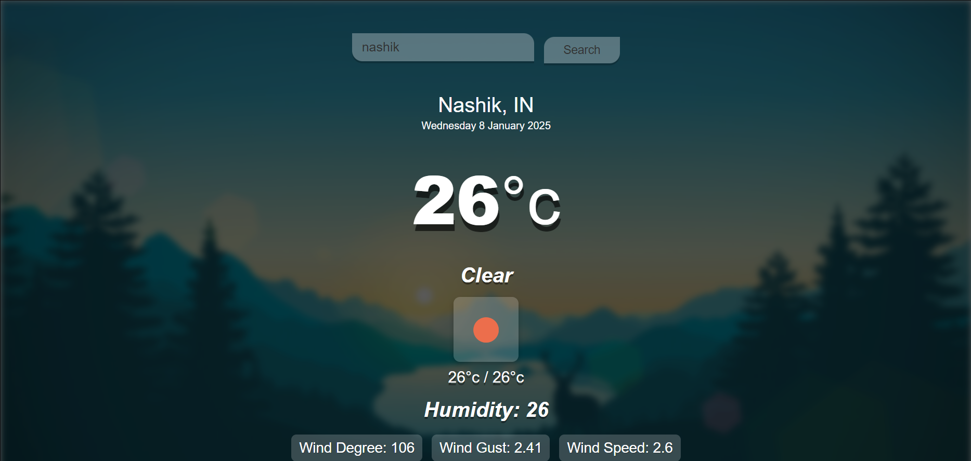
Screenshots

Slide 11



Conclusion and Future Steps
Conclusion:-
Developing this Weather App was a great learning experience, allowing me to enhance my skills in frontend development, API integration, and UI/UX design. The project successfully delivers real-time weather updates with a responsive and user-friendly interface. Implementing error handling and performance optimizations further improved the app’s usability.
Future Steps:-
Add More Weather Details – Include wind speed, humidity, and weekly forecasts.
Improve UI/UX – Enhance design with animations and dark mode support.
Optimize API Calls – Implement location-based weather detection for better efficiency.
Deploy the App – Host it online for easy accessibility.

Slide 12
⥫
Transforming Challenges into Solutions:
Music-player
By Vedant Deshpande
Unified Mentor Internship Project

Slide 13
Introduction to the Project
Search Weather by City – Enter a city name to get real-time weather updates.
The Music Player App is a web-based application designed to provide a seamless music streaming experience. This project was developed during my internship at Unified Mentor to enhance my skills in web development, UI/UX design, and API integration.
This web app allows users to:
Play Local and Online Music – Users can upload and play their own music or stream tracks via the Jamendo API.
Control Playback – Includes essential controls like play, pause, next, previous, seek bar, and volume adjustment.
Search Online Music – Users can search for songs by title or artist from the Jamendo platform.

Slide 14
Identifying Challenges
During the development of the Music Player App, I encountered several challenges that needed to be addressed to ensure a smooth user experience:
🔹 Integrating Jamendo API for accurate online music search.
🔹 Managing smooth audio playback with seeking and volume control.
🔹 Ensuring responsive UI for all screen sizes.
🔹 Handling local music uploads efficiently.
🔹 Dealing with API rate limits for seamless streaming. 🔹 Optimizing user experience with an intuitive interface.
🔹 Ensuring cross-browser compatibility and performance.

Slide 15
Developing Solutions
Jamendo API Integration – Implemented efficient API calls for seamless online music search.
Optimized Audio Playback – Added smooth seek bar and volume control for better user experience.
Responsive Design – Used Tailwind CSS for a fully adaptable UI across all devices.
Efficient Local Music Handling – Enabled easy uploads and organized playlist management.
Performance Optimization – Minimized API calls and improved loading speeds for a seamless experience.

Slide 16
Developing Solutions
Jamendo API Integration.
Implemented API calls to fetch and display online music seamlessly.
Optimized data handling to ensure fast search results and smooth playback.
2. Optimized Audio Playback.
Integrated a custom seek bar for precise track navigation.
Added volume control to adjust sound levels effortlessly.

Slide 17
Developing Solutions
Responsive Design.
Utilized Tailwind CSS for a modern, mobile-friendly interface.
Ensured smooth adaptability across different screen sizes.
4. Efficient Local Music Handling.
Enabled users to upload and organize their music library.
Designed an intuitive UI for easy navigation and management.

Slide 18
Developing Solutions
5. Performance Optimization.
Minimized API calls to reduce loading times.
Implemented lazy loading for images and data to enhance speed.
By combining these techniques, I developed an efficient Music Player App that is easy to use, visually appealing.

Slide 19
Implementation Strategies
To ensure a seamless user experience, we adopted a structured development approach. First, we integrated the Jamendo API to fetch and display online music efficiently. Next, we optimized audio playback by implementing a custom seek bar and volume control for better user interaction. Tailwind CSS was used to design a responsive and visually appealing interface, ensuring compatibility across devices. Additionally, we developed an intuitive local music management system, allowing users to upload and organize their personal library effortlessly. Finally, performance enhancements such as API call optimizations and lazy loading were implemented to reduce loading times and improve overall efficiency.

Slide 20
Output / Results of the Project
Seamless Music Streaming – Users can play both local and online music without interruptions.
User-Friendly Interface – A clean and responsive UI enhances accessibility across all devices.
Efficient Search & Playback – Integrated search functionality enables quick discovery of songs.
Smooth Audio Controls – Custom seek bar and volume control provide better playback management.
Optimized Performance – API calls and lazy loading improve loading speed and reduce latency.

Slide 21
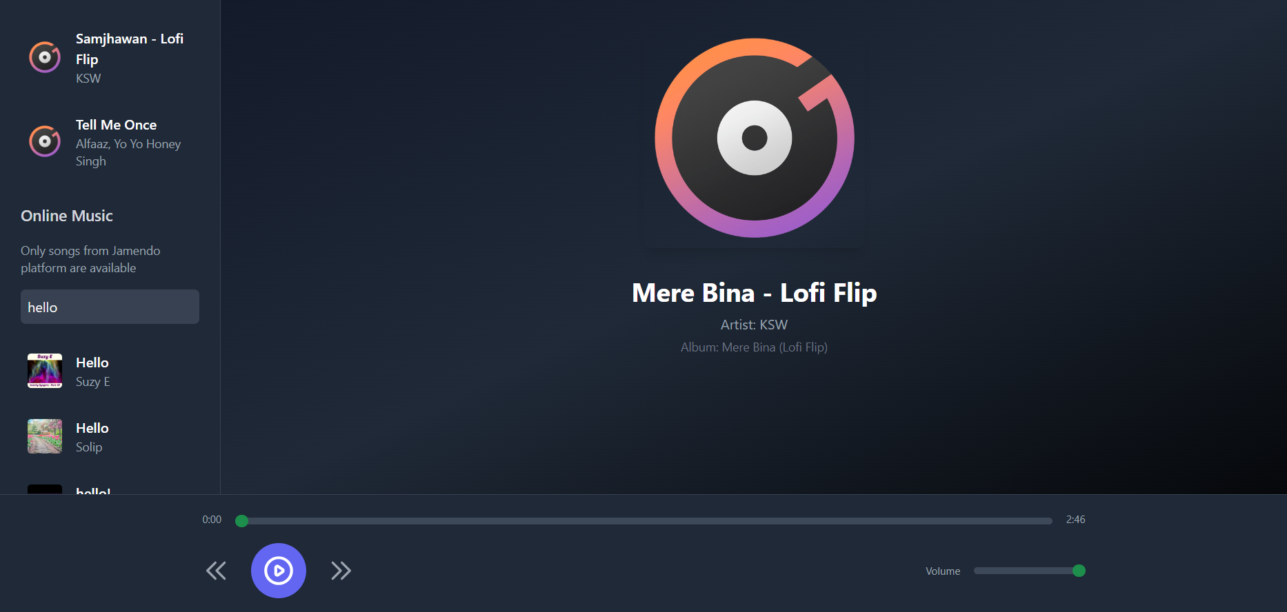
Screenshots

Slide 22
Conclusion and Future Steps
Conclusion:-
This project successfully delivers a seamless music streaming experience, allowing users to play both local and online music with an intuitive interface. The integration of the Jamendo API ensures legal and high-quality music access, while optimized performance enhances user engagement.
Future Steps:-
Enhance Personalization – Implement user preferences for playlists and recommendations.
Offline Playback – Enable song downloads for offline listening.
AI-Powered Recommendations – Use machine learning to suggest music based on user habits.
Improved UI/UX – Refine the design for a more interactive and visually appealing experience.

Slide 23
⥫
Transforming Challenges into Solutions:
Expense-taking-webapp
By Vedant Deshpande
Unified Mentor Internship Project

Slide 24
Introduction to the Project
Search Weather by City – Enter a city name to get real-time weather updates.
Managing personal finances effectively is crucial in today’s fast-paced world. Our Digital Expense Tracker is a web-based application designed to help users track their income and expenses, providing a clear overview of their financial status in real time.
This web app allows users to:
Add Transactions – Users can record income and expenses with details like text, amount, and category.
View Transaction History – Displays a list of all past transactions for easy tracking.
Calculate Balance – Automatically calculates total income, expenses, and net balance.
Real-time Updates - Reflects changes instantly without requiring manual calculations.

Slide 25
Identifying Challenges
During the development of the Digital Expense Tracker, I encountered several challenges that needed to be addressed to ensure a smooth user experience:
🔹 Data Storage - Ensuring reliable transaction storage and retrieval.
🔹 Input Validation - Preventing incomplete or invalid entries.
🔹 Transaction Management - Handling add/delete operations efficiently.
🔹 Balance Accuracy - Maintaining real-time income and expense calculations.
🔹 User Experience - Creating an intuitive and easy-to-use interface.
🔹 Security - Protecting data integrity and preventing unauthorized changes.
🔹 Scalability - Preparing for future database integration.

Slide 26
Developing Solutions
File-Based Storage – Used a JSON file to store and manage transactions efficiently.
Input Validation – Implemented checks to ensure all required fields are provided before processing.
Optimized CRUD Operations – Enabled smooth addition, deletion, and retrieval of transactions via RESTful APIs.
Real-Time Balance Calculation – Automatically updates income, expenses, and net balance based on transactions.
User-Friendly Interface – Designed a simple and interactive UI for seamless expense tracking.

Slide 27
Developing Solutions
File-Based Storage.
Used a structured JSON file to store transactions persistently.
Ensured efficient read/write operations for data consistency.
2. Input Validation.
Implemented validation to check for missing or invalid transaction details.
Prevented incorrect data entries to maintain accurate records.

Slide 28
Developing Solutions
Optimized CRUD Operations.
Enabled seamless addition, retrieval, and deletion of transactions.
Ensured proper error handling for a smooth user experience.
4. Real-Time Balance Calculation.
Automatically updates income, expenses, and net balance.
Filters transactions based on type to provide accurate financial insights.

Slide 29
Developing Solutions
5. User-Friendly Interface.
Designed an intuitive and clean UI for easy navigation.
Ensured responsive design for a better user experience across devices.
By combining these techniques, I developed an efficient Digital Expense Tracker that is easy to use, visually appealing.

Slide 30
Implementation Strategies
The Expense Tracker web application was developed using a structured approach to ensure functionality, performance, and user-friendliness. The backend was implemented using Node.js and Express.js to handle API requests and manage transactions. Data was stored locally in a JSON file, enabling persistent storage of user transactions. The frontend was built using HTML, Tailwind CSS, and JavaScript to provide a responsive and interactive user interface. Comprehensive input validation and error handling were integrated to prevent invalid entries, while real-time balance calculations were performed to give users instant financial insights. The application’s user-centric design ensures seamless navigation, making expense tracking simple and efficient.

Slide 31
Output / Results of the Project
Easy Expense Tracking – Users can add, delete, and categorize transactions effortlessly.
Real-Time Insights – Instantly calculates total income, expenses, and net balance.
User-Friendly UI – Simple and intuitive design for smooth navigation.
Data Persistence – Transactions are saved, ensuring financial history retention.
Better Decision-Making – Helps users analyze spending and manage finances effectively.

Slide 32
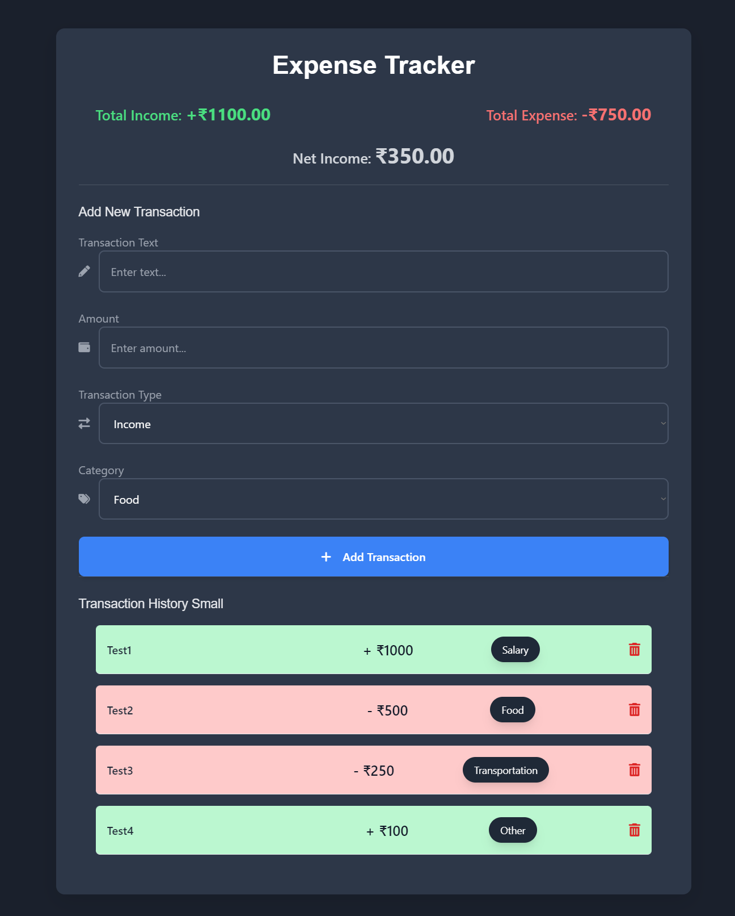
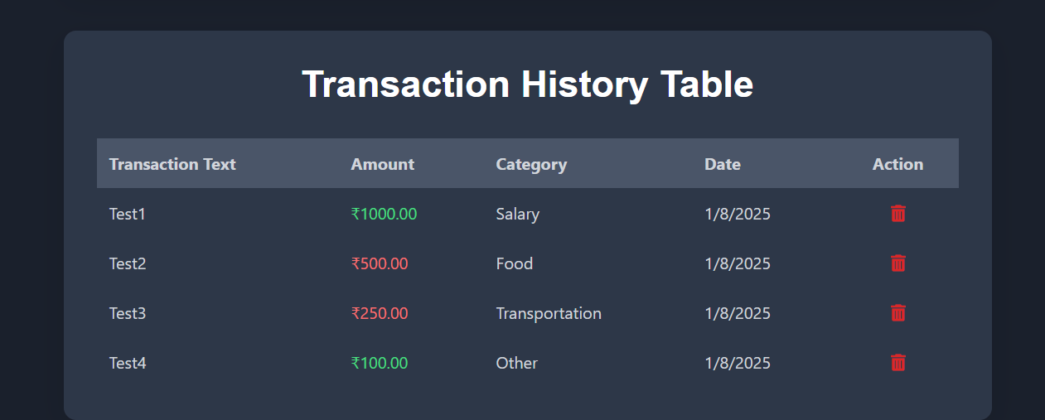
Screenshots

Slide 33
Conclusion and Future Steps
Conclusion:-
This project successfully provides an efficient and user-friendly expense tracking system, enabling users to manage their finances effectively. With real-time balance updates, categorized transactions, and a simple UI, it simplifies financial planning and decision-making.
Future Steps:-
User Authentication – Implement login/signup functionality for personalized tracking.
Cloud Storage – Store transaction data securely using a database like MongoDB or Firebase.
Advanced Analytics – Add charts and insights for better financial analysis.
Mobile Compatibility – Optimize the web app for mobile devices for better accessibility.

Slide 34
⥫
Transforming Challenges into Solutions:
Electric-Vehicle-Recharge-Bunk
By Vedant Deshpande
Unified Mentor Internship Project

Slide 35
Introduction to the Project
Search Weather by City – Enter a city name to get real-time weather updates.
Finding EV charging stations easily is essential for EV owners. Our EV Charging Station Finder helps users locate and book nearby stations, check availability, and navigate seamlessly using interactive maps. Built with Node.js, Express, MongoDB, and Bootstrap 5, it ensures a smooth and efficient charging experience.
This web app allows users to:
Find Charging Stations – Locate nearby EV charging stations with real-time availability.
Book Charging Slots – Reserve a charging slot in advance to avoid wait times.
Live Navigation – Get directions to the selected station using an interactive map.
Check Availability - View which charging slots are occupied or available in real-time.
User Authentication - Secure login system to manage bookings and track usage.

Slide 36
Identifying Challenges
During the development of the EV Charging Station Finder, I encountered several challenges that needed to be addressed to ensure a smooth user experience:
🔹 Real-time Availability Tracking - Ensuring accurate and up-to-date charging slot status.
🔹 User Location Accuracy - Fetching precise user coordinates for better navigation.
🔹 Efficient Booking System - Preventing double bookings and managing reservations effectively.
🔹 Scalability - Handling a growing number of charging stations and users efficiently.
🔹 Data Security - Protecting user information and transaction details from unauthorized access.
🔹 Map Integration Issues - Ensuring seamless loading and interaction of charging stations on the map.
🔹 Connectivity Dependencies - Handling cases where users have poor internet access while booking or navigating.

Slide 37
Developing Solutions
Real-time Updates – Used MongoDB to track and update charging slot availability.
Accurate Geolocation – Integrated the Geolocation API for precise user location.
Secure Booking – Verified slot availability before confirming reservations.
Optimized Maps – Used Leaflet.js for smooth station rendering.
User Security – Implemented JWT authentication and data encryption.

Slide 38
Developing Solutions
Real-time Availability Tracking.
Challenge: Ensuring charging slot data is always up to date.
Solution: Used MongoDB to update slot availability dynamically.
2. User Location Accuracy.
Challenge: Fetching precise coordinates for better navigation.
Solution: Integrated the Geolocation API for accurate user location.

Slide 39
Developing Solutions
Efficient Booking System.
Challenge: Preventing double bookings and managing reservations.
Solution: Verified slot availability before confirming bookings.
4. Scalability.
Challenge: Handling a growing number of stations and users.
Solution: Optimized database queries for faster processing.

Slide 40
Developing Solutions
5. Data Security.
Challenge: Protecting user information from unauthorized access.
Solution: Implemented JWT authentication and encrypted data storage.
By combining these techniques, I developed an efficient EV Charging Station Finder that is easy to use, visually appealing.

Slide 41
Implementation Strategies
To ensure a seamless experience, the EV Charging Station Finder was built using Node.js, Express, MongoDB, and Bootstrap 5 for a responsive and scalable system. Leaflet.js was integrated for an interactive map, allowing users to locate and book charging stations in real time. The Geolocation API enables accurate user location detection, while secure authentication ensures data privacy. A robust booking system prevents double reservations, and real-time updates keep slot availability accurate. Optimized database queries and efficient backend logic enhance performance, making the platform reliable and user-friendly.

Slide 42
Output / Results of the Project
Real-time Station Availability – Users can check and book charging slots instantly.
Accurate Location Tracking – Live geolocation helps users find nearby charging stations.
Seamless Booking System – Prevents double bookings and ensures smooth reservations.
Enhanced User Experience – Responsive design and interactive map improve usability.
Secure & Scalable Platform – Authentication and database optimization ensure reliability.

Slide 43
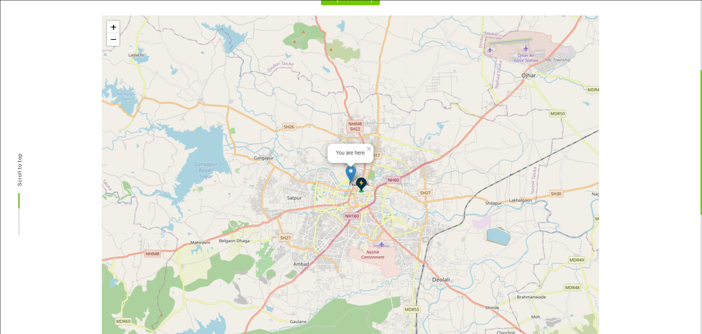
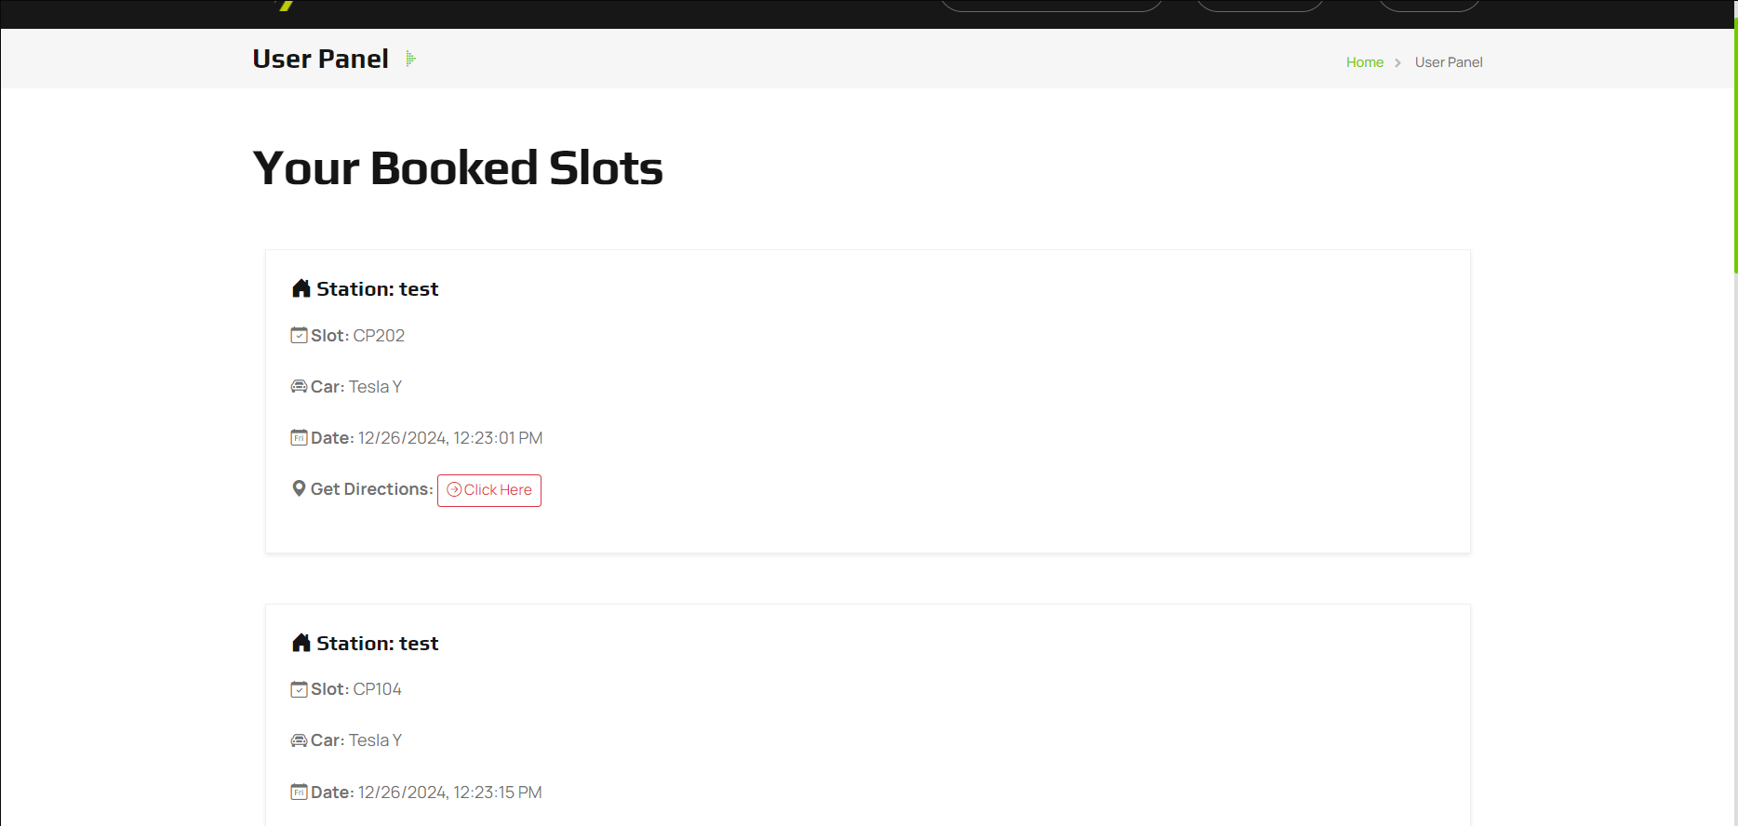
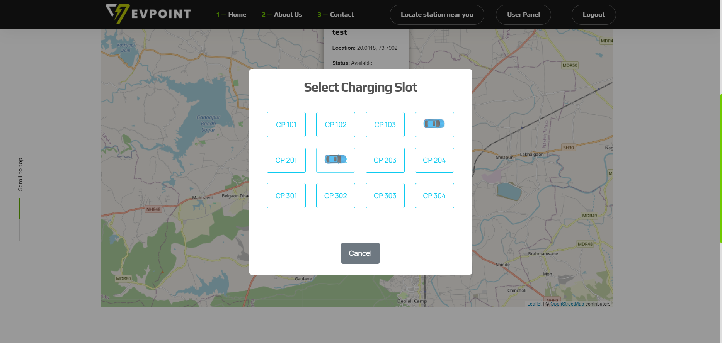
Screenshots

Slide 44
Conclusion and Future Steps
Conclusion:-
The EV Charging Station Finder & Pickup Assistance simplifies charging station booking and roadside assistance with real-time tracking, interactive maps, and secure booking. This platform enhances the EV user experience, making charging and emergency support more accessible and efficient.
Future Steps:-
AI-Based Suggestions – Recommend nearby stations based on user behavior.
Payment Integration – Enable online payments for charging slots.
Mobile App Development – Launch a dedicated app for better accessibility.
Live Notifications – Send real-time updates on bookings and station availability.

Slide 45
⥫
Transforming Challenges into Solutions:
Digital-E-Gram-Panchayat
By Vedant Deshpande
Unified Mentor Internship Project

Slide 46
Introduction to the Project
Search Weather by City – Enter a city name to get real-time weather updates.
Digital E Gram Panchayat is a web-based platform designed to simplify government services for citizens. It bridges the gap between citizens and local governing bodies by providing a user-friendly interface for service applications, status tracking, and record management.
This web app allows users to:
Access Government Services – Citizens can explore and apply for various government services online.
Role-Based Login – Secure authentication for admins, staff, and citizens, ensuring controlled access.
Service Management – Staff can create, update, and manage services efficiently.
Application Tracking - Citizens can check the status of their applications in real-time.
Action Logging - Records all user activities for transparency and accountability.

Slide 47
Identifying Challenges
During the development of the EV Charging Station Finder, I encountered several challenges that needed to be addressed to ensure a smooth user experience:
🔹 Limited Digital Access - Rural areas may lack stable internet and resources.
🔹 User Awareness - Citizens need guidance to adopt digital services.
🔹 Data Security - Protecting sensitive user information.
🔹 Scalability - Handling growing users and service demands.
🔹 Regulatory Compliance - Ensuring adherence to government policies.
🔹 System Maintenance - Regular updates required for smooth functionality.
🔹 Multilingual Support - Need for regional language options to improve accessibility.

Slide 48
Developing Solutions
Offline Support – Implement caching and SMS-based services for areas with poor internet.
User Training – Conduct awareness programs to help citizens navigate the platform.
Enhanced Security – Use encryption and authentication measures to protect data.
Scalable Architecture – Optimize servers and databases to handle high traffic.
Localization Support – Provide multilingual interfaces for better accessibility.

Slide 49
Developing Solutions
Offline Support.
Implement data caching for offline access.
Use SMS/IVR services to provide essential updates.
2. User Training.
Conduct digital literacy workshops for citizens.
Create video tutorials for easy onboarding.

Slide 50
Developing Solutions
Enhanced Security.
Implement end-to-end encryption for data protection.
Use multi-factor authentication (MFA) for secure logins.
4. Scalable Architecture.
Deploy load balancing to manage high traffic.
Use cloud-based solutions for better resource management.

Slide 51
Developing Solutions
5. Localization Support.
Provide regional language options for better accessibility.
Enable voice-assisted navigation for non-tech users.
By combining these techniques, I developed an efficient Digital E Grampanchayat that is easy to use, visually appealing.

Slide 52
Implementation Strategies
The Digital E Gram Panchayat will be implemented in a phased approach to ensure smooth deployment and adoption. Initially, the platform will be developed with core functionalities such as role-based login, service management, and application tracking. Security measures like data encryption and multi-factor authentication will be integrated to protect user data.
To ensure accessibility, the platform will support multilingual interfaces and offline features like SMS-based notifications. Training programs, video tutorials, and community workshops will be conducted to educate users. A scalable cloud infrastructure will be used to handle increasing demand, and regular updates will be deployed for performance improvements and regulatory compliance.

Slide 53
Output / Results of the Project
Simplified Service Access – Citizens can easily apply for government services online.
Efficient Administration – Staff can manage applications and records seamlessly.
Enhanced Transparency – Action logging ensures accountability in governance.
Secure & Scalable System – Strong security measures and cloud-based scalability improve reliability.
Increased Digital Adoption – Awareness programs encourage citizens to use digital governance services.

Slide 54
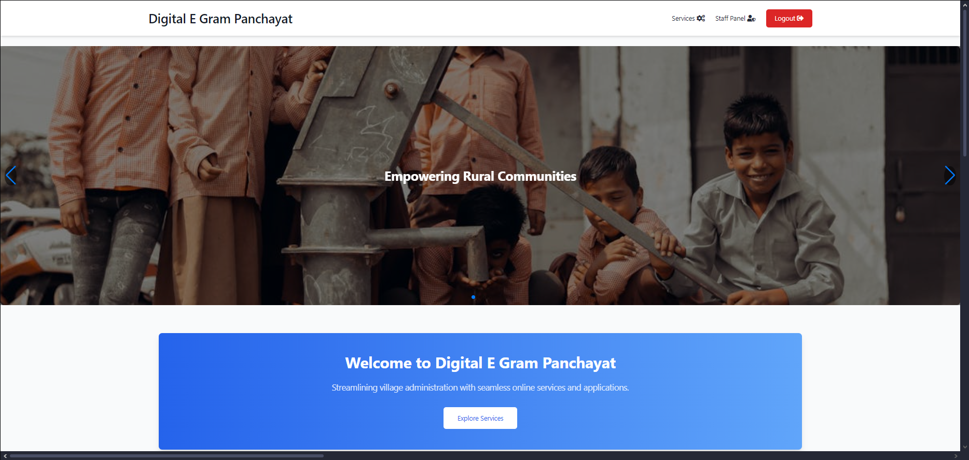
Screenshots

Slide 55
Conclusion and Future Steps
Conclusion:-
The Digital E Gram Panchayat simplifies government services, ensuring secure, transparent, and efficient access for citizens. With role-based authentication, service management, and real-time tracking, it enhances governance while promoting digital adoption and scalability.
Future Steps:-
Mobile App Development – Launch a dedicated mobile app for easier access to services.
AI-Powered Assistance – Integrate AI chatbots for instant citizen support and query resolution.
Blockchain for Security – Enhance data security and transparency using blockchain technology.
Integration with Other Government Portals – Connect with existing e-governance systems for seamless service delivery.

Slide 56








Thanks!
Do you have any questions?
Vedant.Milind.deshpande@gmail.com
+91 9975196491
Vedant Deshpande

